Slide 1
Introduction to AngularJS with SharePoint
By: Dave Feldman
Get started building next-gen portals or
custom user experiences with AngularJS.

Slide 2














@bostonmusicdave
https://www.linkedin.com/in/bostonmusicdavebostonmusicdave@gmail.com
David Feldman

Slide 3


WARNING
CODE
AHEAD

Slide 4
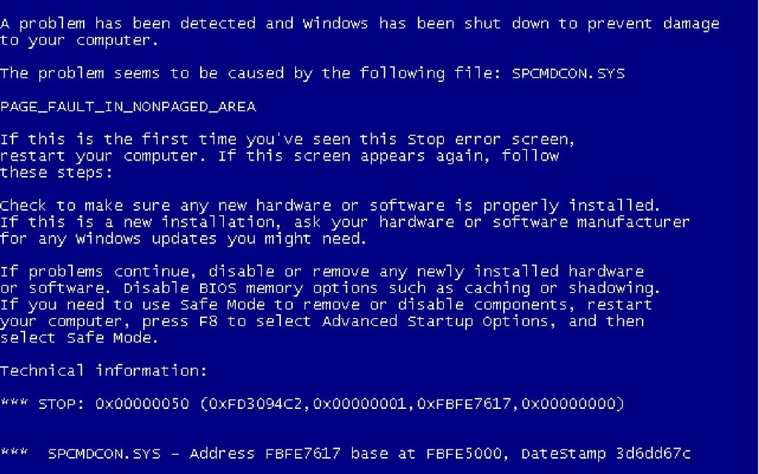

Slide 5
Agenda
App Launcher
& Suite Bar
Why Change
Demo
SharePoint
Search
APIs
All
Together
Now
AngularJS
Intro

Slide 6

Why Change
THE WORLD HAS CHANGED

Slide 7

SharePoint Development Story
Recommended approach over time
SharePoint 2007
SharePoint 2010
SharePoint 2013
Office 365
Farm
Solutions
Farm
Solutions
Farm
Solutions
Sandbox
Solutions
Sandbox
Solutions
Sandbox
Solutions
No Code
Sandbox
Solutions
Provider
Hosted Add-in
No Code
Sandbox
Solutions
SharePoint
Hosted Add-in
Provider
Hosted Add-in
Office 365
Apps
SharePoint
Hosted Add-in

Slide 8
Key Takeaways 2016
SharePoint development story changes a-lot
Avoid extending with server code in SharePoint!
Avoid sandbox solutions with code
Client JavaScript is fine
Run Server code somewhere else

Slide 9

Microsoft NextGen Portal Architecture
Ignite 2015
Table of Contents Control
Video Player
Single Page App
Page Renderer
Authoring
Canvas
Get Started Experience
Homepage
Content
Pages
Image Control
Page Rollup
JavaScript Controls
Core SharePoint APIS
(Docs, Search, Graph)
Ready-to-go Publishing
Video Portal
Rich Text Editor
Document Control
Server
REST APIs
Hub
Site Collection
Content
Site Collection

Slide 10
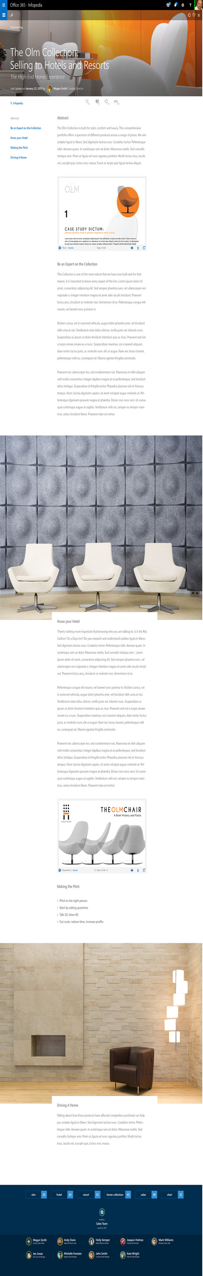
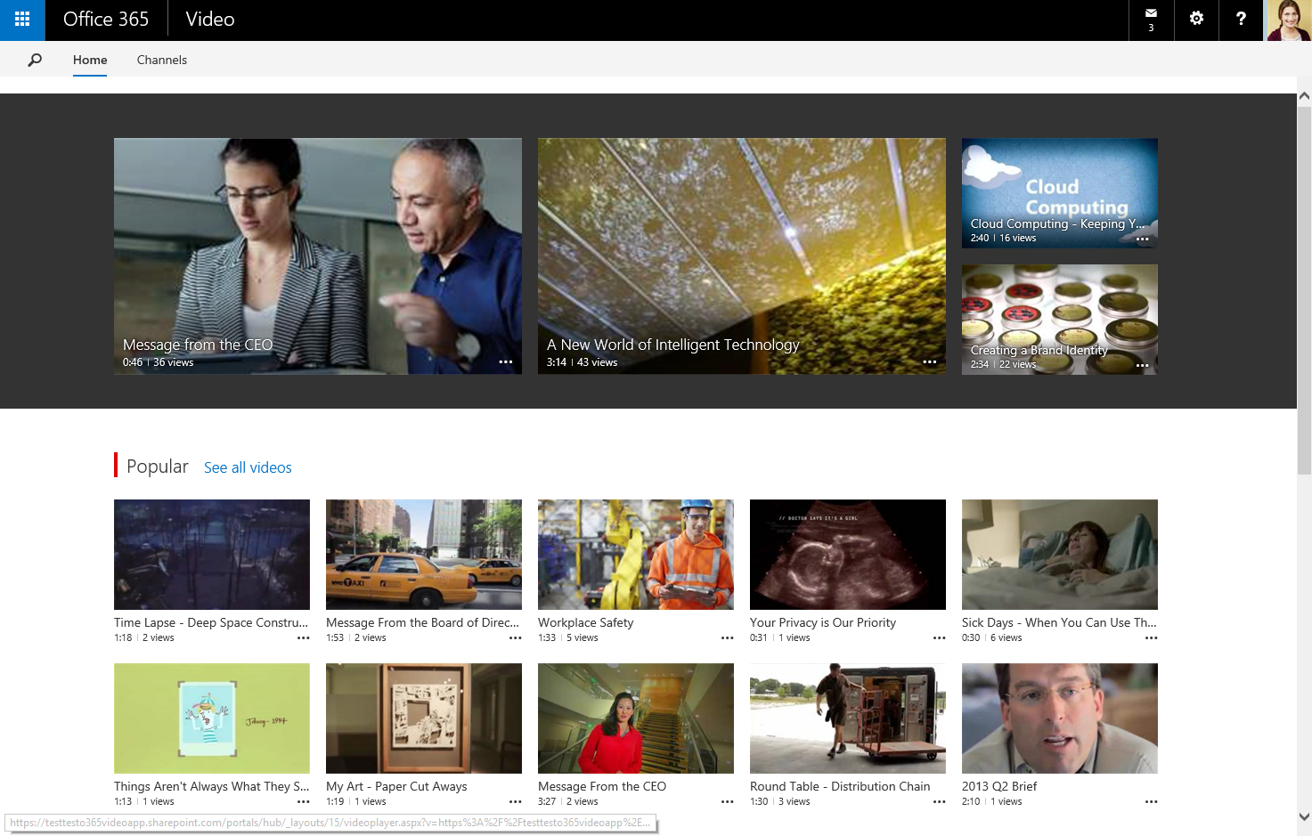
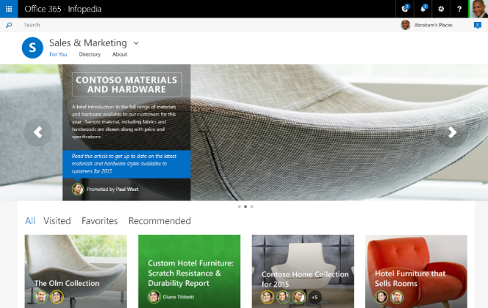
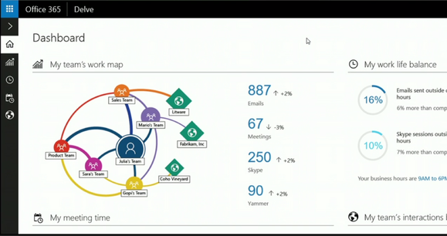
Key Facts / Takeaways
SharePoint today is written in ASP.NET WebForms
WebForms is not part of ASP.NET 5
Server REST APIs are good
Responsive Single Page Apps for new UX

Slide 11

Demo

Slide 12
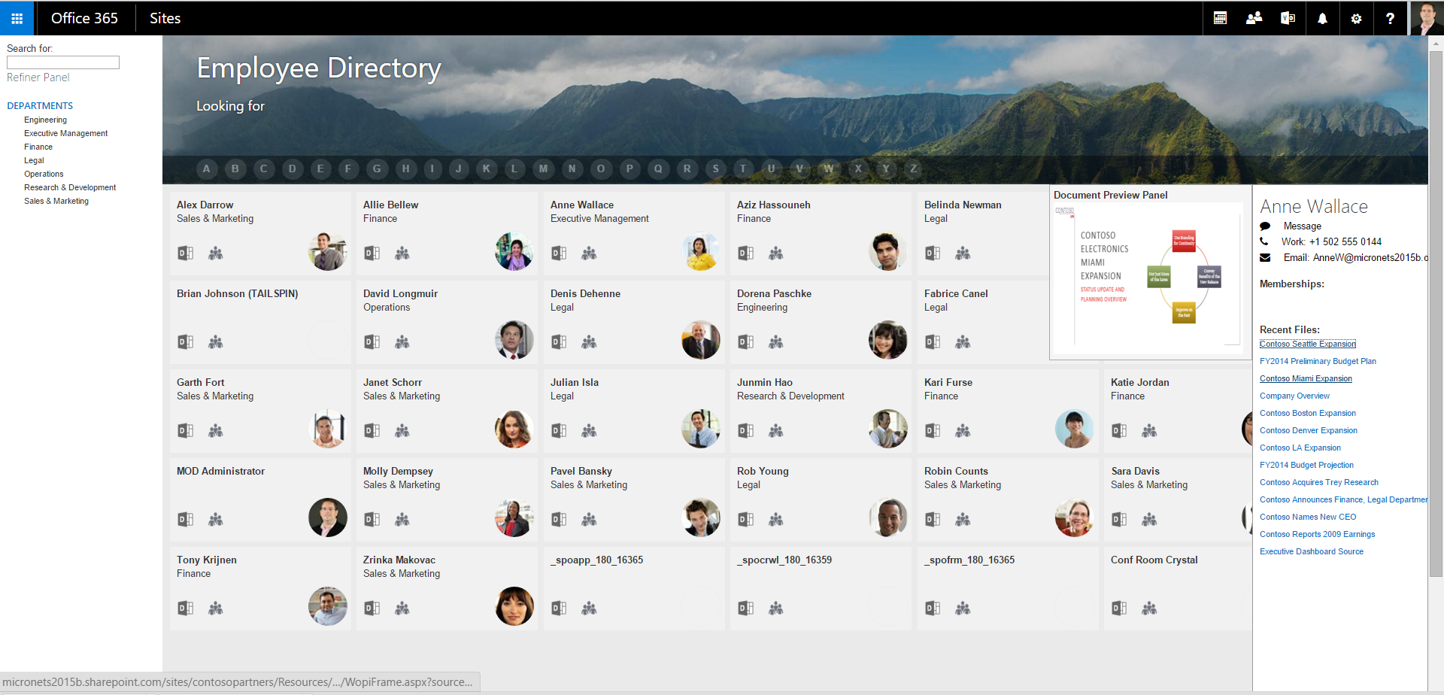
Office 365 Employee Directory

Slide 13

App Launcher
& Suite Bar

Slide 14
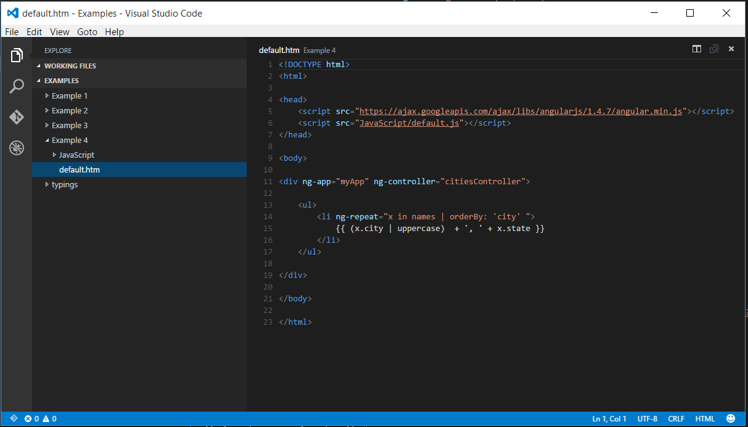

Setting up our environment
SharePoint Document Library
OneDrive for Business Sync Agent
Visual Studio Code

Slide 15
UI Fabric & Suite bar
http://dev.office.com/fabric
Office UI Fabric is a responsive, mobile-first, front-end framework that you can use to apply the Office Design Language to your web experiences. Whether you’re creating a new app or add-in or updating an existing one, Fabric makes it easy to get up and running.
Suite bar has no documented approach from Microsoft
Watch Office UI Fabric for a future component
We can leverage SharePoint’s controls today

Slide 16
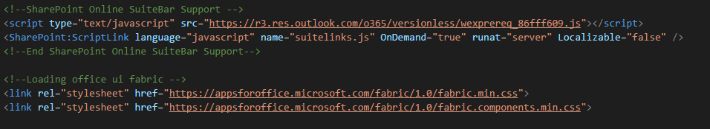
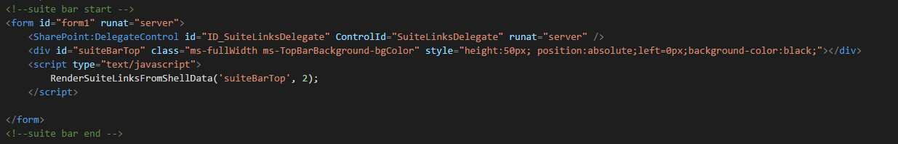
Embedding the SuiteBar & UI Fabric
Demo 1
Head
Body

Slide 17
Generated for the Suite Bar & App Launcher
Don’t try to just copy all these
<!--SharePoint Init - Required for SuiteBar--> <script type="text/javascript" src="https://static.sharepointonline.com/bld/_layouts/15/16.0.4524.1212/1033/initstrings.js"></script> <script type="text/javascript" src="https://static.sharepointonline.com/bld/_layouts/15/16.0.4524.1212/init.js"></script> <script type="text/javascript" src="https://static.sharepointonline.com/bld/_layouts/15/16.0.4524.1212//online/scripts/sposuitenav.js"></script> <script type="text/javascript">RegisterSod("require.js", "https:\u002f\u002fstatic.sharepointonline.com\u002fbld\u002f_layouts\u002f15\u002f16.0.4524.1212\u002frequire.js");</script> <script type="text/javascript">RegisterSod("strings.js", "https:\u002f\u002fstatic.sharepointonline.com\u002fbld\u002f_layouts\u002f15\u002f16.0.4524.1212\u002f1033\u002fstrings.js");</script> <script type="text/javascript">RegisterSod("sp.res.resx", "https:\u002f\u002fstatic.sharepointonline.com\u002fbld\u002f_layouts\u002f15\u002f16.0.4524.1212\u002f1033\u002fsp.res.js");</script> <script type="text/javascript">RegisterSod("sp.runtime.js", "https:\u002f\u002fstatic.sharepointonline.com\u002fbld\u002f_layouts\u002f15\u002f16.0.4524.1212\u002fsp.runtime.js");RegisterSodDep("sp.runtime.js", "sp.res.resx");</script> <script type="text/javascript">RegisterSod("sp.js", "https:\u002f\u002fstatic.sharepointonline.com\u002fbld\u002f_layouts\u002f15\u002f16.0.4524.1212\u002fsp.js");RegisterSodDep("sp.js", "sp.runtime.js");RegisterSodDep("sp.js", "sp.ui.dialog.js");RegisterSodDep("sp.js", "sp.res.resx");</script> <script type="text/javascript">RegisterSod("sp.init.js", "https:\u002f\u002fstatic.sharepointonline.com\u002fbld\u002f_layouts\u002f15\u002f16.0.4524.1212\u002fsp.init.js");</script> <script type="text/javascript">RegisterSod("sp.ui.dialog.js", "https:\u002f\u002fstatic.sharepointonline.com\u002fbld\u002f_layouts\u002f15\u002f16.0.4524.1212\u002fsp.ui.dialog.js");RegisterSodDep("sp.ui.dialog.js", "sp.init.js");RegisterSodDep("sp.ui.dialog.js", "sp.res.resx");</script> <script type="text/javascript">RegisterSod("core.js", "https:\u002f\u002fstatic.sharepointonline.com\u002fbld\u002f_layouts\u002f15\u002f16.0.4524.1212\u002fcore.js");RegisterSodDep("core.js", "strings.js");</script> <script type="text/javascript">RegisterSod("suitelinks.js", "https:\u002f\u002fstatic.sharepointonline.com\u002fbld\u002f_layouts\u002f15\u002f16.0.4524.1212\u002fsuitelinks.js");RegisterSodDep("suitelinks.js", "strings.js");RegisterSodDep("suitelinks.js", "core.js");</script> </head><body>
<!--suite bar start --> <form method="post" action="index.aspx" id="form1"> <div class="aspNetHidden"><input type="hidden" name="__VIEWSTATE" id="__VIEWSTATE" value="/wEPDwUBMGRk8E+nfjqV6Sbt1atsgipUrkmLksSsYwLNQoiyjLPtBT4=" /></div> <script type="text/javascript"> //<![CDATA[ var g_presenceEnabled = true; var g_wsaEnabled = true; var g_correlationId = 'd95a399d-004e-2000-4500-9b01f68c592f'; var g_wsaQoSEnabled = false; var g_wsaQoSDataPoints = []; var g_wsaRUMEnabled = true;var g_wsaLCID = 1033; var g_wsaListTemplateId = 101; var g_wsaSiteTemplateId = 'STS#0'; var _fV4UI=true;var _spPageContextInfo = {webServerRelativeUrl: "\u002fsites\u002fDemo", webAbsoluteUrl: "https:\u002f\u002fmicronets2015b.sharepoint.com\u002fsites\u002fDemo", siteAbsoluteUrl: "https:\u002f\u002fmicronets2015b.sharepoint.com\u002fsites\u002fDemo", serverRequestPath: "\u002fsites\u002fDemo\u002fShared Documents\u002fDirectoryStep1 - Ribbon\u002findex.aspx", layoutsUrl: "_layouts\u002f15", webTitle: "Demo", webTemplate: "1", tenantAppVersion: "1864042944", isAppWeb: false, webLogoUrl: "_layouts\u002f15\u002fimages\u002fsiteicon.png", webLanguage: 1033, currentLanguage: 1033, currentUICultureName: "en-US", currentCultureName: "en-US", clientServerTimeDelta: new Date("2015-10-20T04:27:43.7437778Z") - new Date(), updateFormDigestPageLoaded: new Date("2015-10-20T04:27:43.7437778Z"), siteClientTag: "12$$16.0.4524.1216", crossDomainPhotosEnabled:true, webUIVersion:15, webPermMasks:{High:2147483647,Low:4294967295},pageListId:"{80139653-caae-4f24-8019-c6fa3fd2a659}",pageItemId:265, pagePersonalizationScope:1,userId:9,userLoginName:"admin@micronets2015b.onmicrosoft.com", systemUserKey:"i:0h.f|membership|10030000935d42f9@live.com", alertsEnabled:true, siteServerRelativeUrl: "\u002fsites\u002fDemo", allowSilverlightPrompt:'True', isSiteAdmin: true, env: "Prod"};Flighting.ExpFeatures = [-1935704048,1880353632,1561415760,302071836,-1826945232,-1796975744,12582919,-2090324963,4785188,-838729728,1065872,-536678120,2013373056,1099542787,34141134,1879965696,69208178,256,16777216,0,0,0,0,0,0,0,0,0,0,0,0,1792,0,0,0,0,0,0,0,0,0,0,0,0,0,0,0,0,0,0,0,0,0,0,0,0,0,0,0,0,0,0,0,0,0,0,0,0,0,0,0,0,0,0,0,0,0,0,0,0,0,524288,0,0,32768];(function()
if (typeof(_spBodyOnLoadFunctions) === 'undefined' || _spBodyOnLoadFunctions === null) {
return;
}
_spBodyOnLoadFunctions.push(function() {
SP.SOD.executeFunc('core.js', 'FollowingDocument', function() { FollowingDocument(); });
});
})();(function(){
if (typeof(_spBodyOnLoadFunctions) === 'undefined' || _spBodyOnLoadFunctions === null) {
return;
}
_spBodyOnLoadFunctions.push(function() {
SP.SOD.executeFunc('core.js', 'FollowingCallout', function() { FollowingCallout(); });
});
})();if (typeof(DeferWebFormInitCallback) == 'function') DeferWebFormInitCallback();//]]>
</script>
<div class="aspNetHidden">
<input type="hidden" name="__VIEWSTATEGENERATOR" id="__VIEWSTATEGENERATOR" value="80C2AC45" />
</div>
<script type="text/javascript">
//<![CDATA[
RenderSuiteLinksFromShellData('suiteLinksBox', 1);
//]]>
</script>
</form>
<div id="suiteBarTop" class="ms-fullWidth ms-TopBarBackground-bgColor" style="height:50px; position:absolute;left=0px;background-color:black;"></div>
<script type="text/javascript">
RenderSuiteLinksFromShellData('suiteBarTop', 2);
</script>
<!--suite bar end -->
</body>
</html>

Slide 18
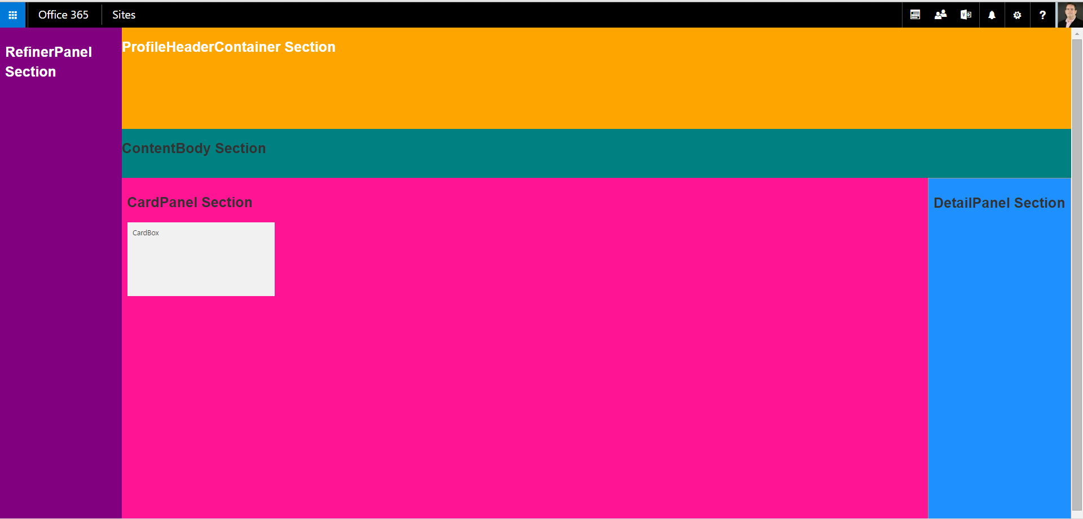
Tips for creating responsive layouts
Demo 2
Avoid tables, Prefer div, li, ul…
Leverage CSS for Layout
Use browser developer tools (f12) to work through styles
Comment Generously

Slide 19

AngularJS
Intro

Slide 20
What is AngularJS?
AngularJS is a prescriptive JavaScript framework or library written entirely in JavaScript.
AngularJS is distributed as a JavaScript file, and can be added to a web page with a script reference:
<head>
<script src="https://ajax.googleapis.com/ajax/libs/angularjs/1.4.7/angular.min.js"></script>
</head>

Slide 21
AngularJS Extends HTML
AngularJS extends HTML with ng-directives.
The ng-app directive defines an AngularJS application.
The ng-model directive binds the value of HTML input controls (input, select, textarea) to application data.
The ng-bind directive binds application data to the HTML view.

Slide 22
Demo 3
Example 1: Basic data binding
<!DOCTYPE html>
<html>
<head>
<script src="https://ajax.googleapis.com/ajax/libs/angularjs/1.4.7/angular.min.js"></script>
</head>
<body>
<div ng-app="">
<p>Name: <input type="text" ng-model="name"></p>
<p ng-bind="name"></p>
</div>
</body>
</html>
AngularJS starts automatically when the web page has loaded.
The ng-app directive tells AngularJS that the <div> is the "owner" of an AngularJS application.
The ng-model directive binds the value of the input field to the application variable name.
The ng-bind directive binds the innerHTML of the <p> element to the application variable name.

Slide 23
Setting some default values
<div ng-app="" ng-init="firstName=‘Dave'"> <p>The name is <span ng-bind="firstName"></span></p> </div>

Slide 24
Expressions
AngularJS expressions are written inside double braces: {{ expression }} and will "output" data exactly where the expression is written. Expressions can also be used for data binding.
<div ng-app="">
<p>Math time: {{ 2 + 2 }}</p>
</div>
<div ng-app=""> <p>Name: <input type="text" ng-model="name"></p> <p>{{name}}</p> </div>

Slide 25
Demo 4
Modules & Controllers
AngularJS modules define AngularJS applications.
AngularJS controllers control AngularJS applications.
The ng-app directive defines the application, the ng-controller directive defines the controller.
Controllers can contain properties or methods
JAVASCRIPT
HTML
var app = angular.module('myApp', []);
app.controller('myCtrl', function ($scope) {
$scope.firstName = "Dave";
$scope.lastName = "Feldman";
$scope.twitter = "@bostonmusicdave"; $scope.askabout = function () {
if ($scope.twitter == "@bostonmusicdave") {return "AngularJS and Office 365";}
else
{return $scope.firstName + " " + $scope.lastName + "'s skills";}
}
});
<div ng-app="myApp" ng-controller="myCtrl"> First Name: <input type="text" ng-model="firstName"><br> Last Name: <input type="text" ng-model="lastName"><br> Contact {{firstName + " " + lastName}} on twitter at {{twitter}} to talk some more about {{askabout()}} </div>
Notes:
The AngularJS application is defined by ng-app="myApp".
The ng-controller="myCtrl" attribute is an AngularJS directive. It defines a single controller.
The myCtrl function is a JavaScript function.
AngularJS will invoke the controller with a $scope object.
In AngularJS, $scope is the application object (the owner of application variables and functions).
The controller creates three properties (variables) in the scope (firstName, lastName, twitter).
The ng-model directives bind the input fields to the controller properties (firstName, lastName, twitter).

Slide 26
Repeaters with collections and ng-repeat
Demo 5
When a controller property returns a collection, the ng-repeat directive enables
easy definition of an html template for each item in the collection
HTML
JAVASCRIPT
<div ng-app="myApp" ng-controller="citiesController">
<ul>
<li ng-repeat="x in names">
{{ x.city + ', ' + x.state }} </li>
</ul>
</div>
angular.module('myApp', []).controller('citiesController', function($scope) {
$scope.names = [
{city:'Boston',state:'MA'},
{city:'Watertown',state:'MA'},
{city:'Burlington',state:'MA'},
{city:'Warwick',state:'RI'},
{city:'Nashua',state:'NH'}
];
});

Slide 27
Transforming data with Angular Filters
Demo 6
A filter can be added to an expression with a pipe character (|) and a filter.
<div ng-app="myApp" ng-controller="citiesController">
<ul>
<li ng-repeat="x in names | orderBy: 'city' ">
{{ (x.city | uppercase) + ', ' + x.state }}
</li>
</ul>
</div>
Filter | Description
currency | Format a number to a currency format.
filter | Select a subset of items from an array.
lowercase | Format a string to lower case.
orderBy | Orders an array by an expression.
uppercase | Format a string to upper case.

Slide 28
Key Takeaways
Define the app and controller
Controllers contain methods and properties
Bind input into the model
Use expressions, ng-bind, or ng-repeat to output
Transform data with filters

Slide 29

SharePoint
Search
APIs

Slide 30
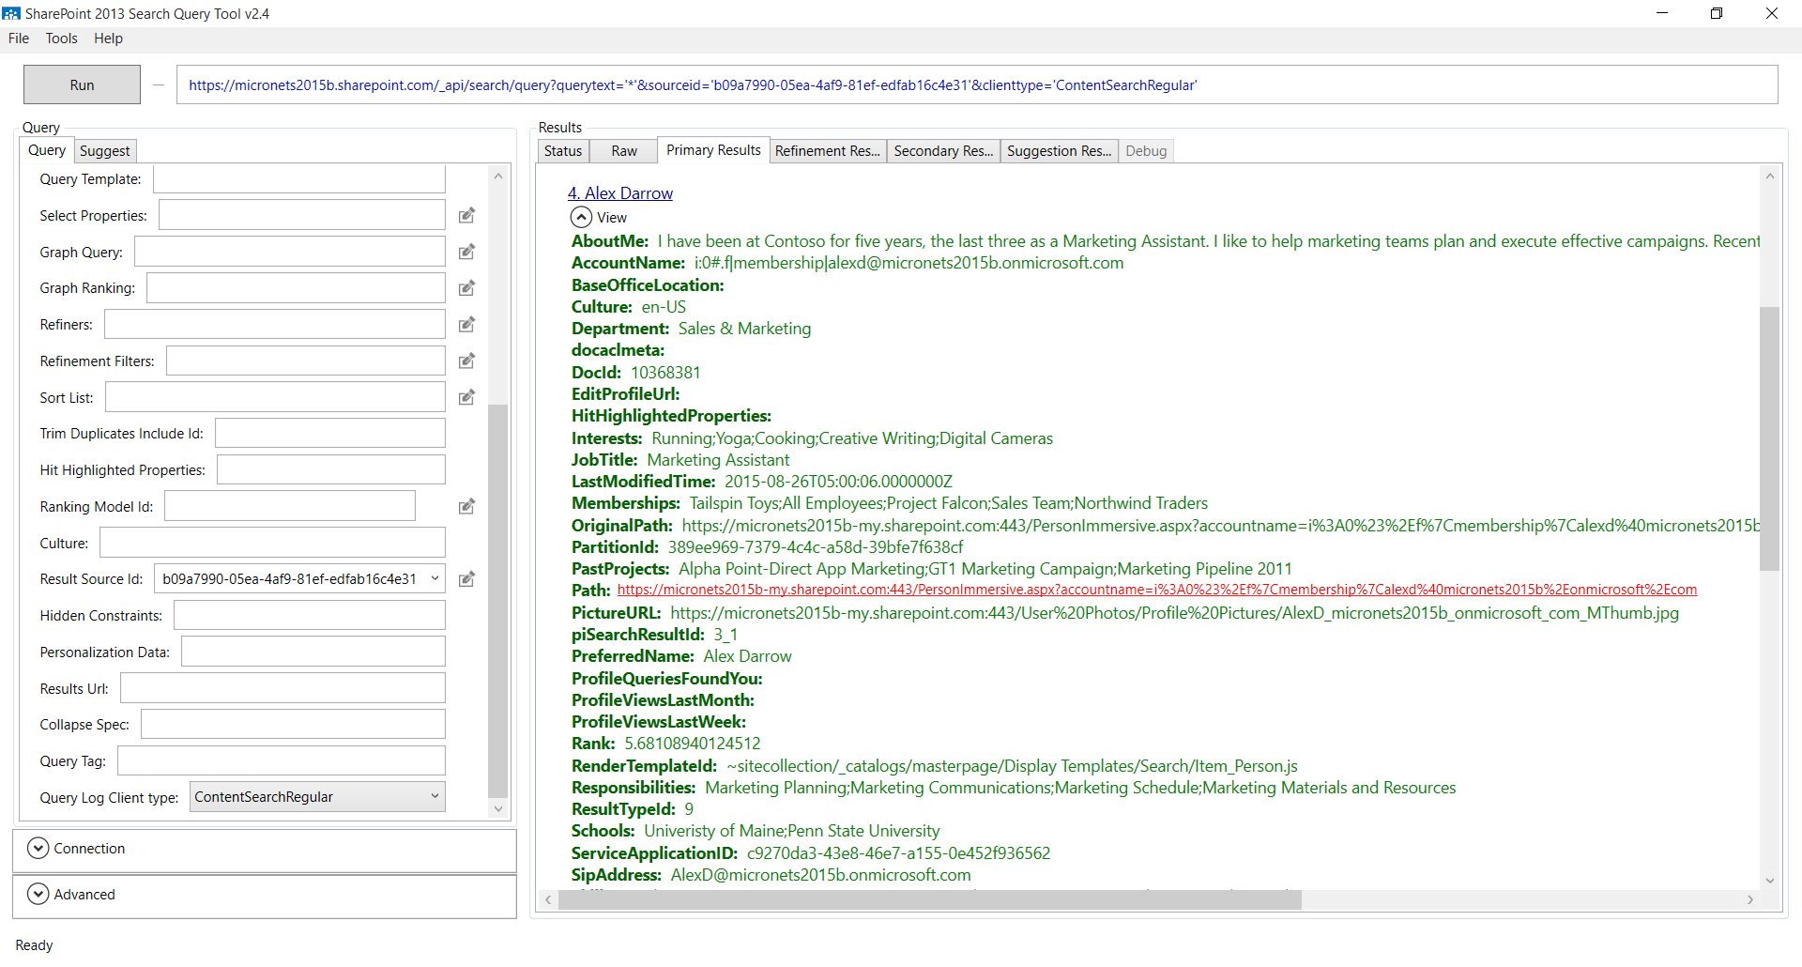
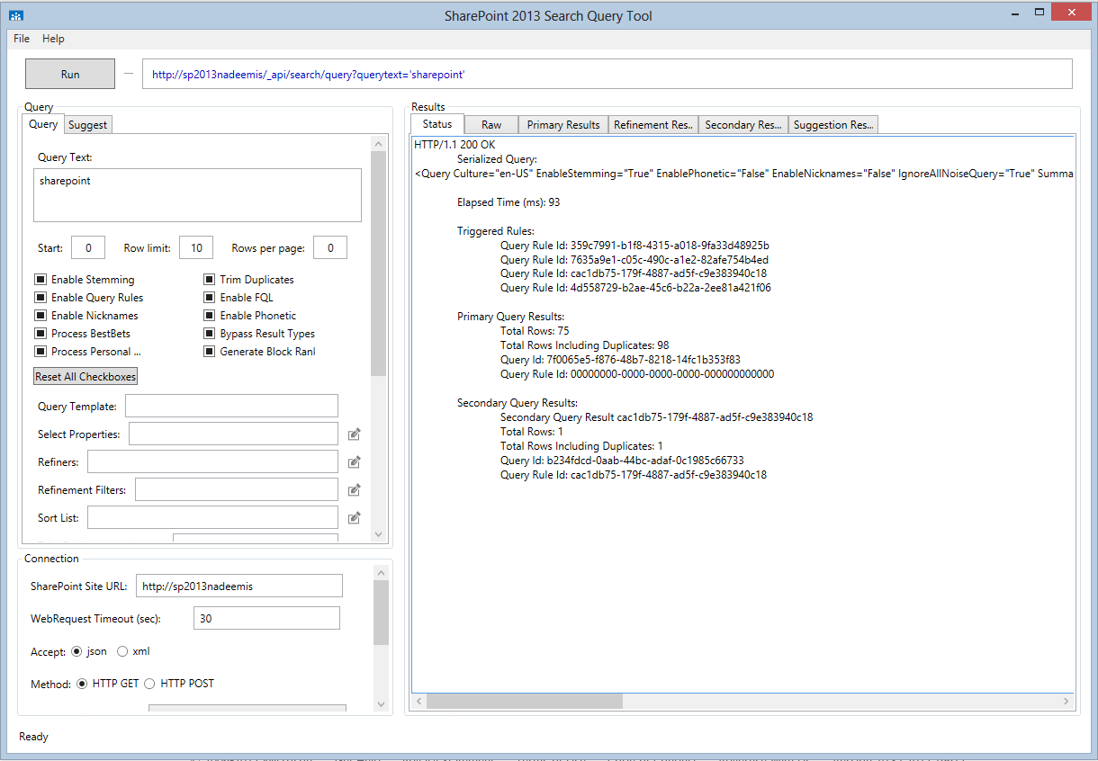
SharePoint 2013 Search Query Tool
http://sp2013searchtool.codeplex.com/

Slide 31
Build the URL for the SharePoint REST API
Define the Properties to return from search
var selectProperties = "&selectproperties='Department,JobTitle,Memberships,Path,PictureURL,PreferredName,SipAddress,Skills,WorkEmail, WorkPhone,MobilePhone,Colleagues,OfficeNumber,HierarchyUrl,DocId '&sortlist=‘LastNameSortable:Ascending'“
Encode Search Refiners if utilized
if (typeof($scope.selectedRefiners) != "undefined" && $scope.selectedRefiners != "not available" && $scope.selectedRefiners.length>0)
{
refinerText = "&refinementfilters='" + encodeURIComponent($scope.selectedRefiners[0]) + ":\"" + encodeURIComponent($scope.selectedRefiners[1]) + "*\"'" ;
searchUrl = _spPageContextInfo.webAbsoluteUrl + "/_api/search/query?querytext='PreferredName:" + queryText + "*'" + refinerText +“ &sourceid='B09A7990-05EA-4AF9-81EF-EDFAB16C4E31'&rowlimit=30&refiners='Department(sort=name/ascending)'" + selectProperties ;
}
else
Default search without refiners
{
searchUrl = _spPageContextInfo.webAbsoluteUrl + "/_api/search/query?querytext='PreferredName:" + queryText + "*‘ &sourceid='B09A7990-05EA-4AF9-81EF-EDFAB16C4E31'&rowlimit=30&refiners='Department(sort=name/ascending)'" + selectProperties ;
}

Slide 32
Build the URL for the SharePoint REST API
The SharePoint Search REST API also enables us to query the Office Graph using Graph Query Language
JavaScript property created by SharePoint
var searchUrl = _spPageContextInfo.webAbsoluteUrl + "_api/search/query?querytext='*‘
&rowlimit=30
&sourceid='8413cd39-2156-4e00-b54d-11efd9abdb89‘
&clienttype='ContentSearchRegular‘
&properties='GraphQuery:ACTOR(" + person.DocId + "\\, action\\:1003)'";
People Search Source
Graph ObjectID is the DocID property returned from SharePoint search
Recently Modified

Slide 33
SharePoint RequestExecutor (CrossDomain)
The cross-domain library is designed to simplify JavaScript by removing the need to work with OAuth tokens.
var executor = new SP.RequestExecutor(_spPageContextInfo.webAbsoluteUrl);
executor.executeAsync(
{
url: searchUrl,
method: "GET",
headers: { "Accept": "application/json; odata=verbose" },
success: onGetSearchResultsSuccess,
error: onGetSearchResultsFail
}
);

Slide 34
onGetSearchResultsSuccess(data)
Getting the data back from SharePoint and ready to bind to our UI
Parse the results from the REST Response
var jsonObject = JSON.parse(data.body);
var results = jsonObject.d.query.PrimaryQueryResult.RelevantResults.Table.Rows.results;
Add each result into a collection of results
var ResultList = []
$.each(results, function (index, result) {
Parse the Tenant Name and Email Address to build the link to Delve
var delveUrl = _spPageContextInfo.webAbsoluteUrl.split(".")[0] + "-my.sharepoint.com/_layouts/15/me.aspx?p=" + encodeURIComponent(result.Cells.results[10].Value) + "&v=work";
Push each result from search into the structured collection ResultList.push({
Department:result.Cells.results[2].Value, JobTitle:result.Cells.results[3].Value,
Memberships:result.Cells.results[4].Value.split(";"),
Path:result.Cells.results[5].Value, PictureURL:result.Cells.results[6].Value,
PreferredName:result.Cells.results[7].Value, SipAddress:result.Cells.results[8].Value,
Skills:result.Cells.results[9].Value, WorkEmail:result.Cells.results[10].Value, WorkPhone:result.Cells.results[11].Value, MobilePhone:result.Cells.results[12].Value, OfficeNumber:result.Cells.results[13].Value, HierarchyUrl:result.Cells.results[14].Value,
DelveURL:delveUrl, DocId:result.Cells.results[1].Value });
});

Slide 35

All
Together
Now

Slide 36
Person Card Template
This basic unordered list is used to create the cards for the rows returned from SharePoint Search
<!--Start the main content body -->
<div class="cardPanel" id="cardPanel">
<ul class="cardPanelUL" id="cardPanelUL">
<li ng-repeat="x in searchResults" class="cardBox" id="cardBox" ng-click="itemSelected(x)">
<ul class="cardPanelUL" >
<li class="CardTitle">{{x.PreferredName}}</li>
<li class="CardText"> </li>
<li class="CardText">{{x.Department}}</li>
<li class="CardText"><img class="CardPhoto" src="//outlook.office365.com/owa/service.svc/s/GetPersonaPhoto?email={{x.WorkEmail}}"/></li>
<li class="CardText"><a href="{{x.DelveURL}}" target="_delve"><img class="CardDelve" src="Images/delve.png"/></a></li>
<li class="CardText"><a href="{{x.Path}}" target="_delve"><img class="CardOrg" src="Images/org.png"/></a></li>
</ul>
</li>
</div>

Slide 37
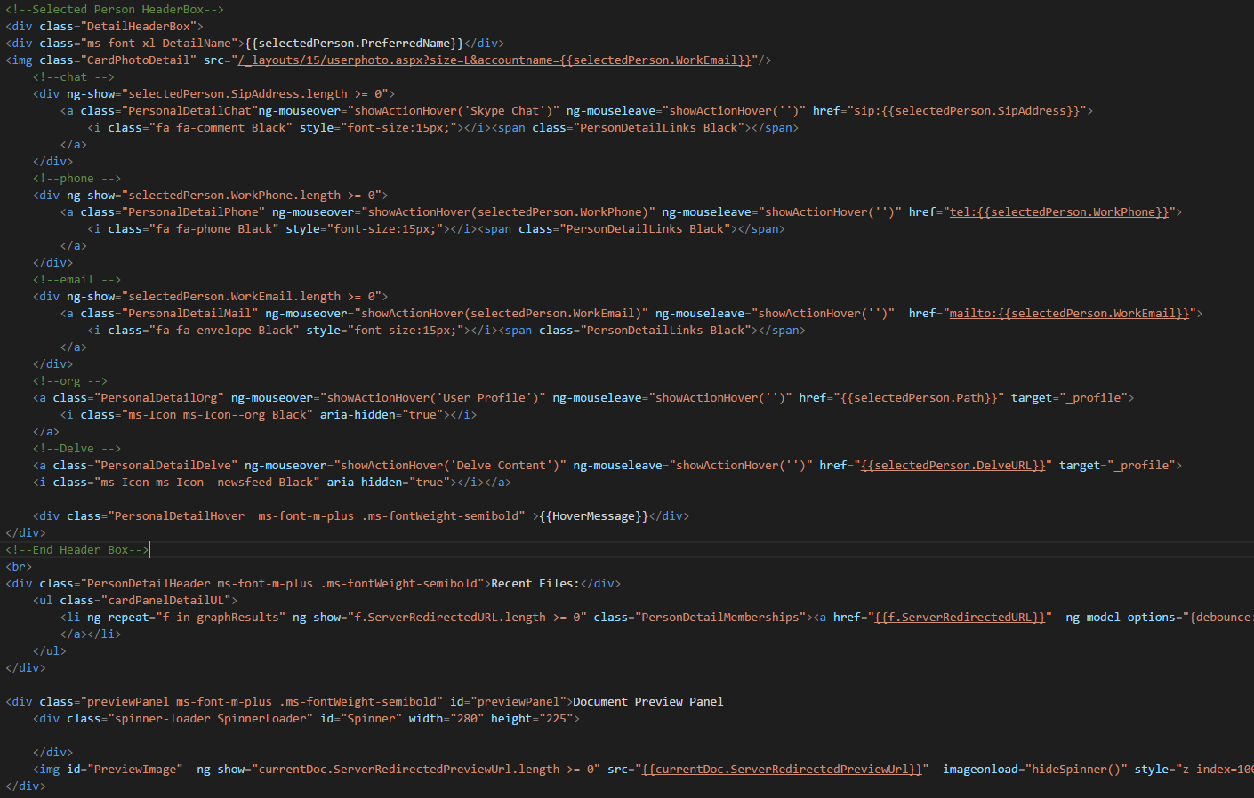
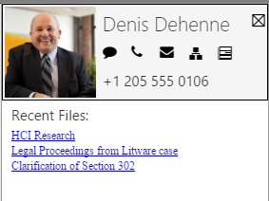
Person Detail Template
Conditional CSS using ng:class, Animation using Office UI Fabric, Hover Details with ng-MouseOver

Slide 38
Takeaways for Next Gen App Builders
Use a client side framework such as AngularJS with SharePoint APIs to produce clean, performant apps
Get the HTML and CSS right first with plenty of comments
Angular makes DataBinding information from SharePoint APIs easy
Check out the full source code on ITUnity’s Github

Slide 39

Thank You

